Slide 1
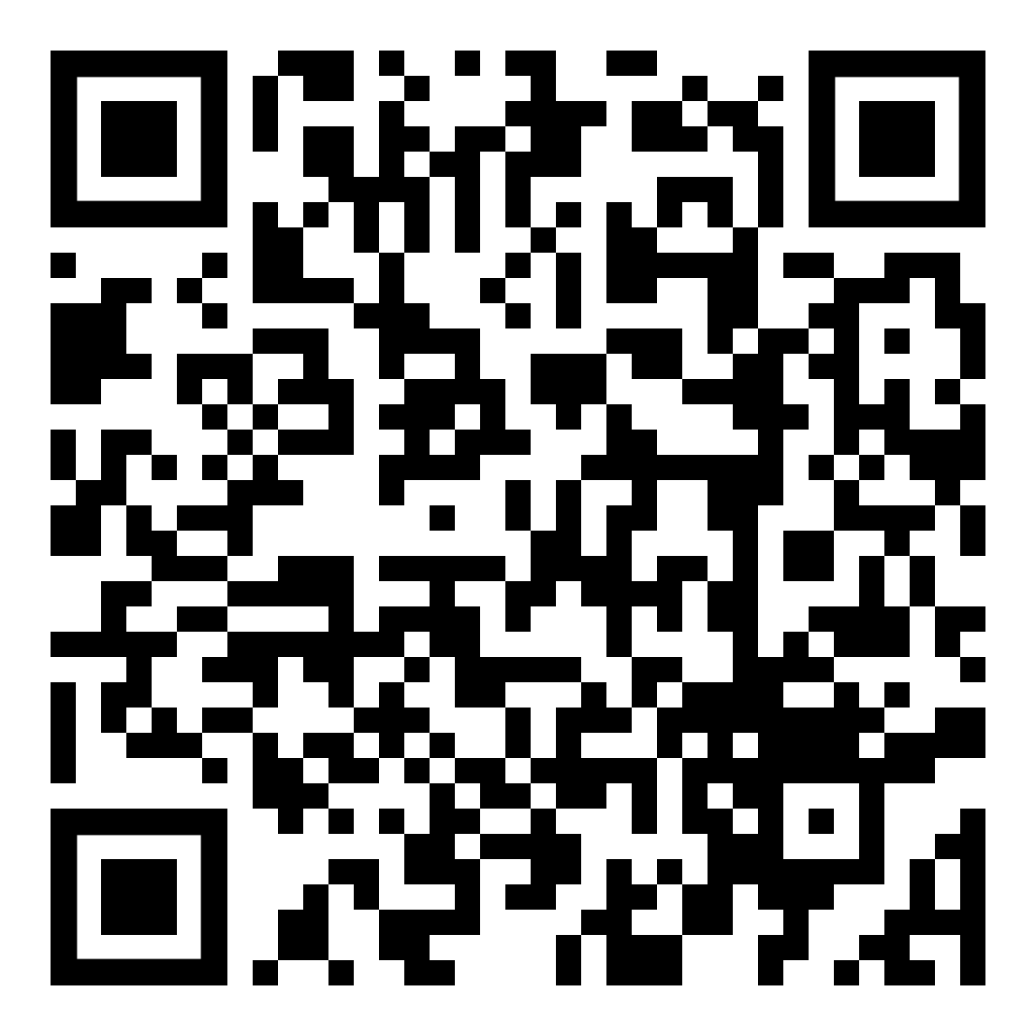
To Claim Attendance
Code is valid for 14 days.
Activity Date: date
Activity Code: code
Go to: NortonRSS.com or scan the code:
Disclosure
Planners: The planners of this activity have no relevant conflicts of interest to disclose.
Speaker: The speaker, enter speakers name, discloses the following relationship(s)
Company name - relationship (if multiple relationships and/or individuals with relationship(s) list all)
All relevant relationships have been successfully mitigated prior to this activity.
Physicians
Accreditation: Norton Healthcare is accredited by the Kentucky Medical Association to provide continuing medical education for physicians.
Designation: Norton Healthcare designates this live activity for a maximum of 1.00 AMA PRA Category 1 Credit(s) ™. Physicians should claim only the credit commensurate with the extent of their participation in the activity.

Slide 2
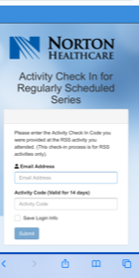
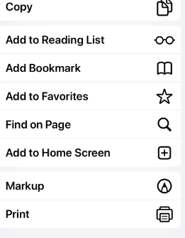
TIP: Add link to home screen for quick access
NortonRSS.com

