Slide 1
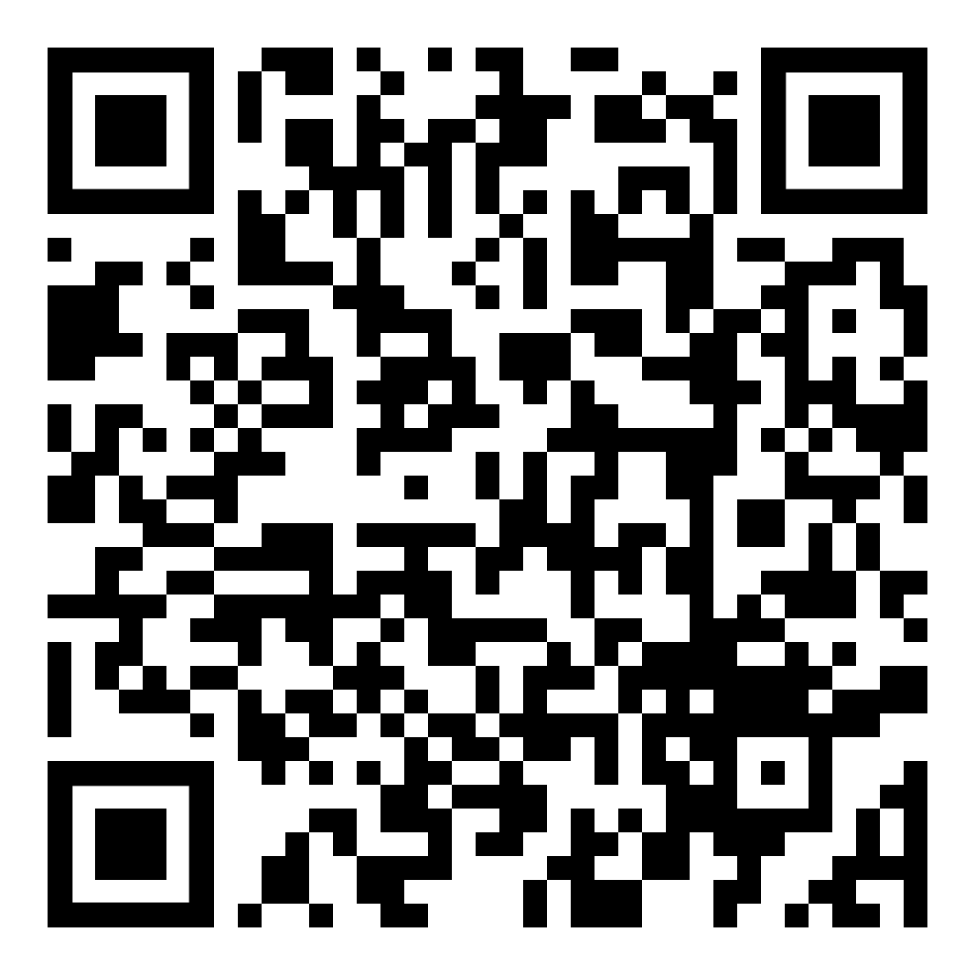
To Claim Attendance
Code is valid for 14 days.
Activity Date: date
Activity Code: code
Go to: NortonRSS.com or scan the code:
Disclosure
Planners: The planners of this activity have no financial relationships with ineligible companies to disclose.
Speaker: The speaker, enter speakers name, discloses the following relationship(s)
Company name - type of relationship (if multiple relationships and/or individuals with relationship(s) list all)
All relevant relationships have been successfully mitigated prior to this activity.
Physicians
Accreditation: This activity has been planned and implemented in accordance with the accreditation requirements and policies of the Accreditation Council for Continuing Medical Education through the joint providership of Norton Healthcare and add name of joint provider. Norton Healthcare is accredited by the Kentucky Medical Association to provide continuing medical education for physicians.
Designation: Norton Healthcare designates this live activity for a maximum of 1.00 AMA PRA Category 1 Credit(s) ™. Physicians should claim only the credit commensurate with the extent of their participation in the activity.

Slide 2
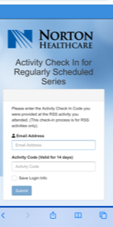
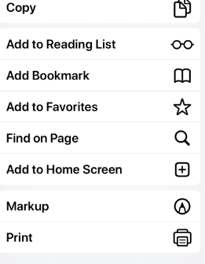
TIP: Add link to home screen for quick access
NortonRSS.com

