Slide 1
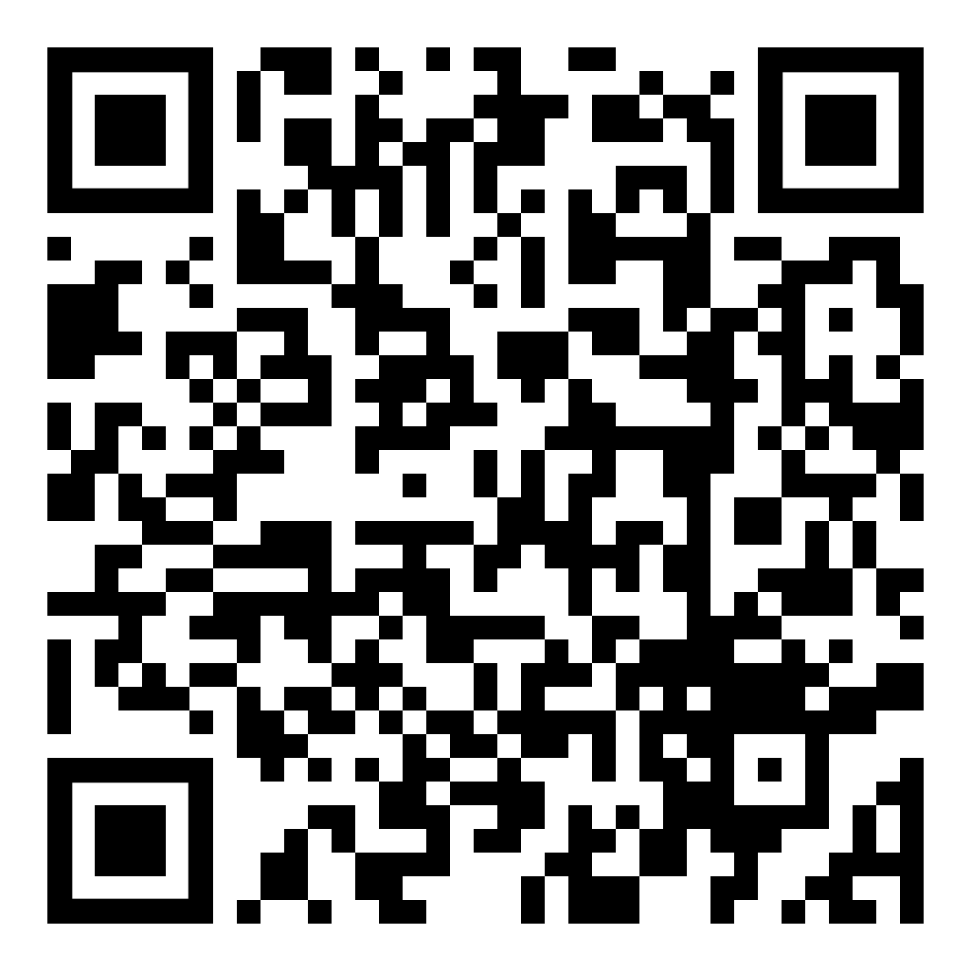
To Claim Attendance
Activity Date: date
Code is valid for 14 days.
Activity Code: code
Go to: NortonRSS.com or scan the code:
Disclosure: The planners and speakers of this activity have no relevant conflicts of interest to disclose.
Physicians
Accreditation: This activity has been planned and implemented in accordance with the accreditation requirements and policies of the Accreditation Council for Continuing Medical Education through the joint providership of Norton Healthcare and add name of joint provider. Norton Healthcare is accredited by the Kentucky Medical Association to provide continuing medical education for physicians.
Designation: Norton Healthcare designates this live activity for a maximum of 1.00 AMA PRA Category 1 Credit(s) ™. Physicians should claim only the credit commensurate with the extent of their participation in the activity.

Slide 2
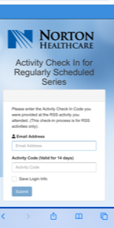
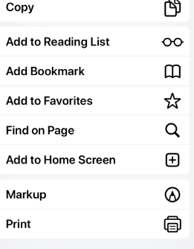
TIP: Add link to home screen for quick access
NortonRSS.com

